Slide 1
Context Clues
Decoding and Understanding unknown words
(without using a dictionary)

Slide 2
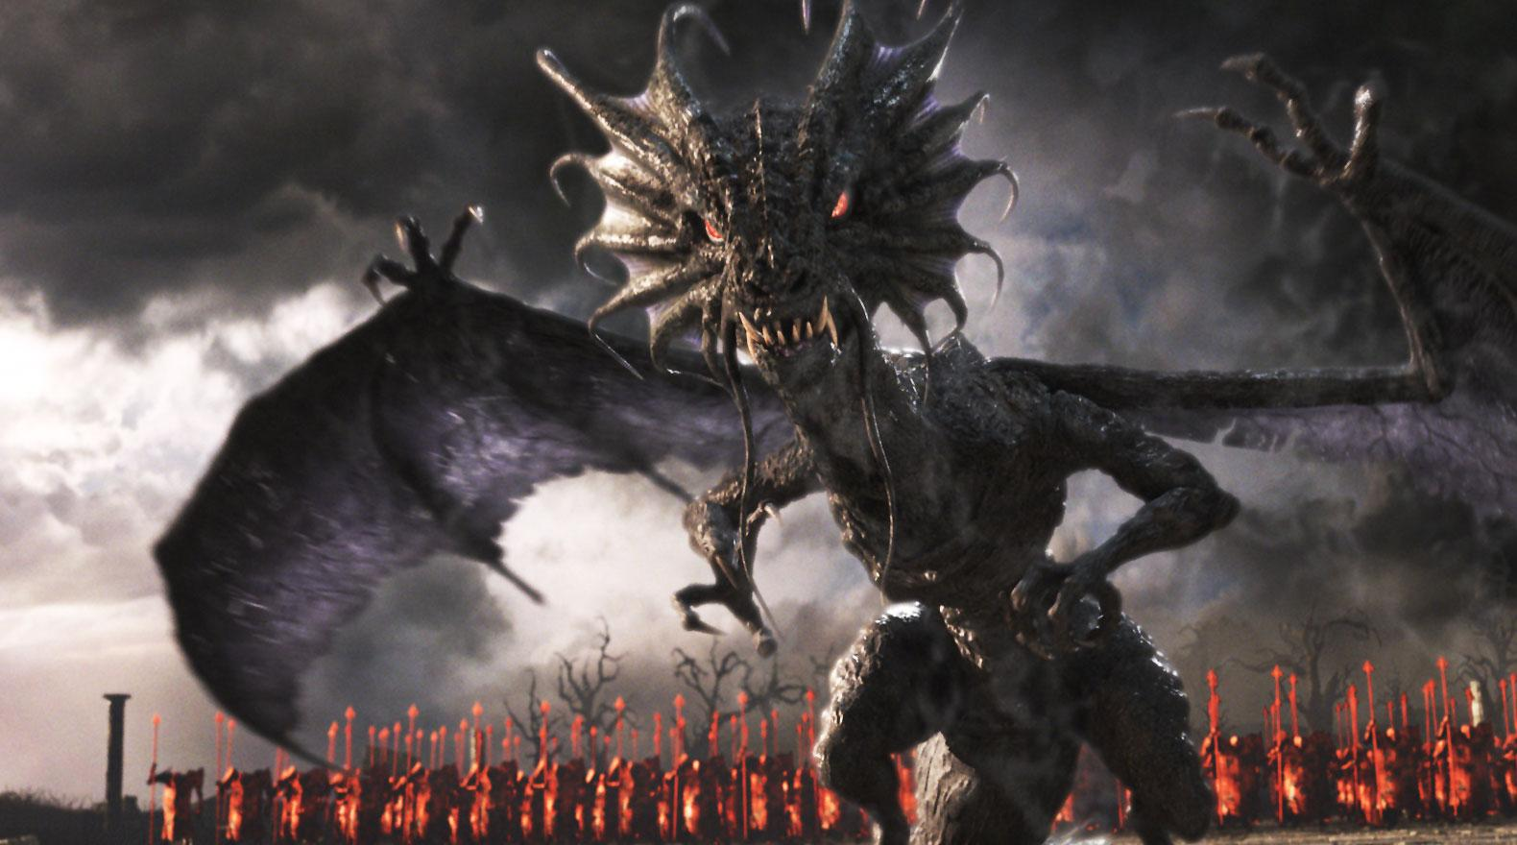
Nonsense words in “Jabberwocky”
Brillig
Slithy
Toves
Gyre
Gimble
Wabe
Mimsy
Borogoves
Mome raths
Outgrabe
Jabberwock
Jubjub bird
Frumious
Bandersnatch
Vorpal
Manxome
Tumtum tree
Uffish
Whiffling
Tulgey
Burbled
Snicker-snack
Galumphing
Beamish
Frabjous
Callooh
Callay
Chortled

Slide 3
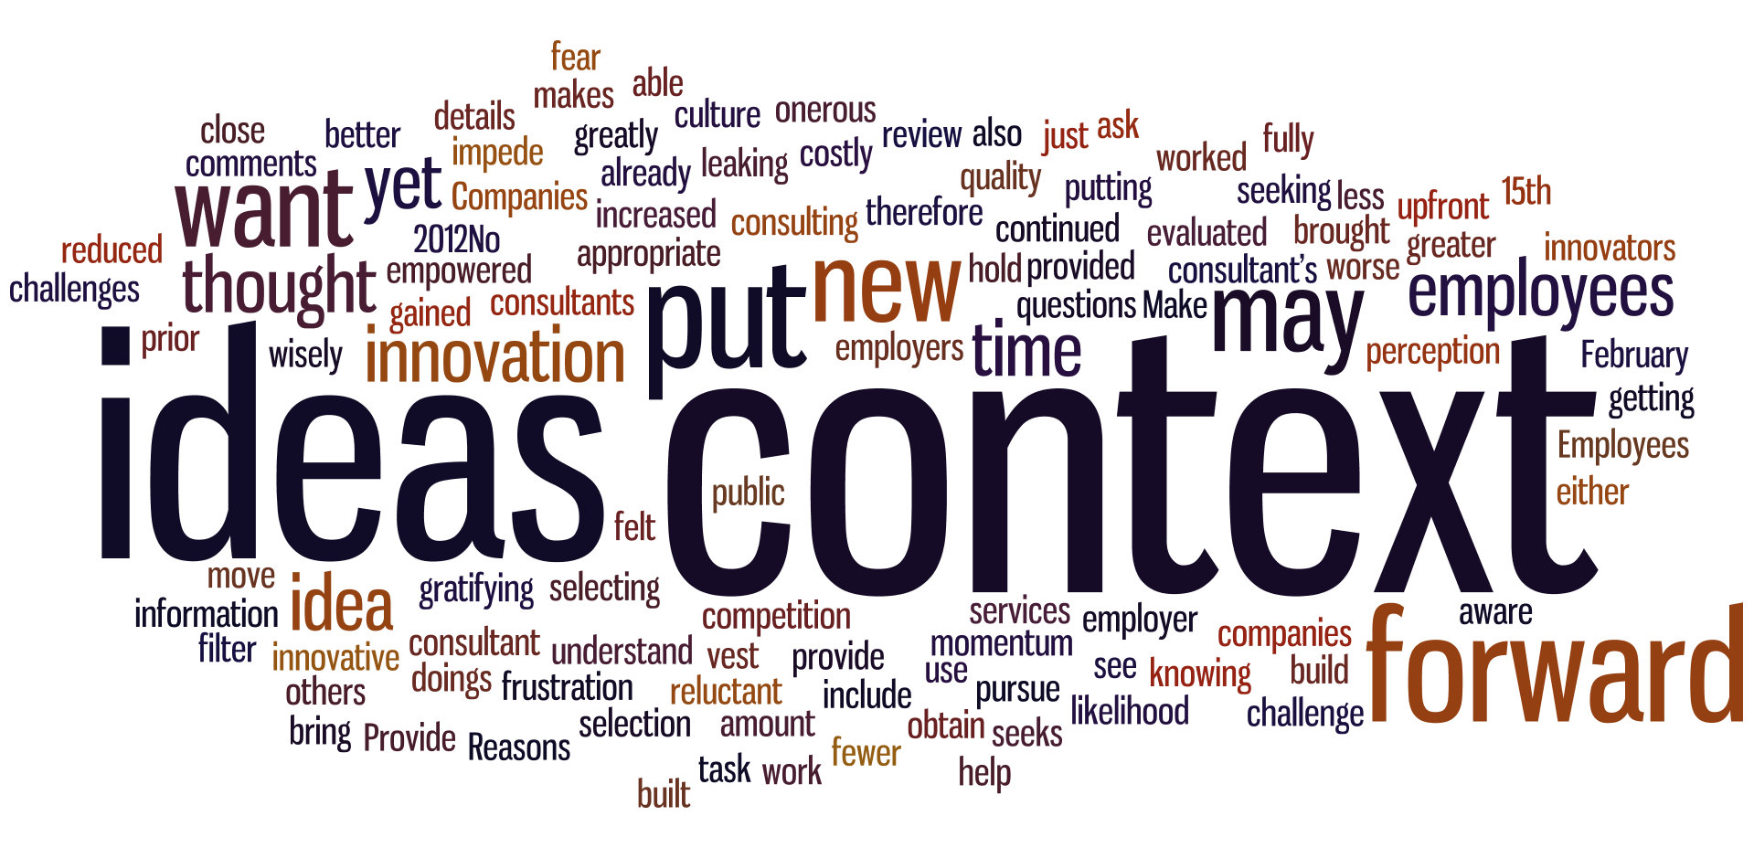
Context Clues
Examples
Synonyms
Antonyms
General Sense of Passage
4 Types
Context literally means “with text”
Some clues to words meanings are right in the text itself.

Slide 4
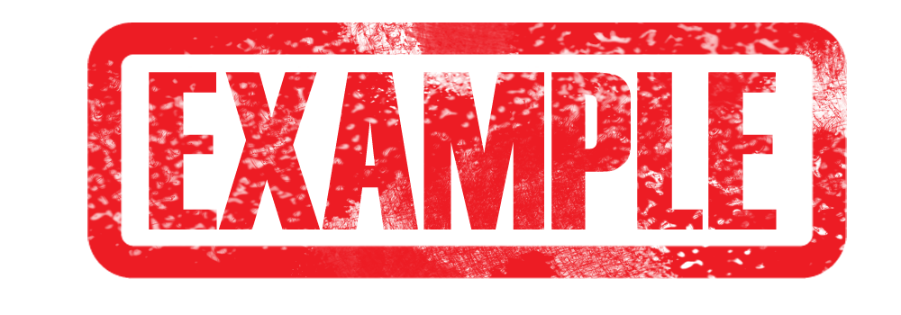
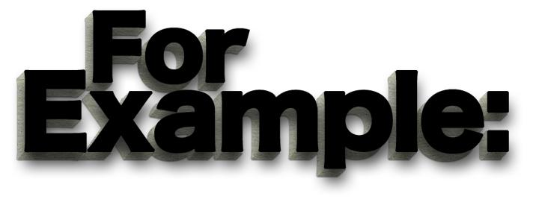
Examples
Sometimes, a passage may give you a clue to the meaning of a word by saying, “For example,” or “For instance.”
The man was robust. For example, he stood 6 feet tall, had large muscles, and was very widely built.
Sometimes it may not include “for example,” or “for instance.”
The man was robust. He stood 6 feet tall, had large muscles, and was very widely built.
However, this is still an example and gives you a clue as to the meaning of the word.

Slide 5
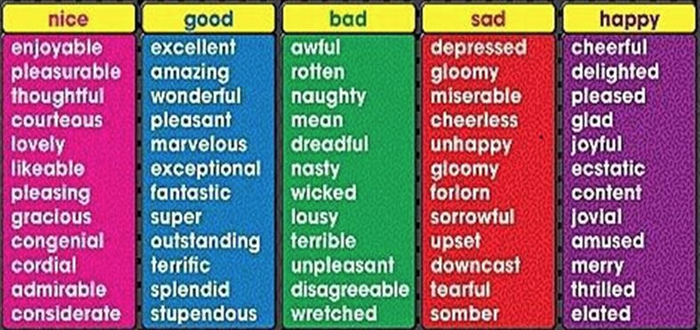
Synonyms
Meaning “‘with’ or ‘same’ words,” Synonyms are words that mean the same thing or are similar.
Robust, booming, hearty, hefty, powerful, sturdy, tough, strong.
The man was a robust man, powerful, sturdy, and tough.
The man was robust. A strong, hearty man like him would have no trouble.
Look for the keyword “like.”

Slide 6
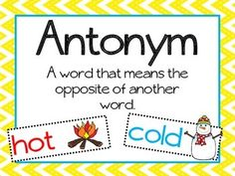
Antonyms
Just the opposite of synonyms - They are words that mean the opposite.
good/bad, happy/sad, grow/shrink, big/small, robust/fragile, small, weak, unstable
The man was robust. He was in no way small or weak.
The man was not small or weak at all. Instead, he was rather robust.
Look for keywords like “rather,” “instead,” “actually.”

Slide 7
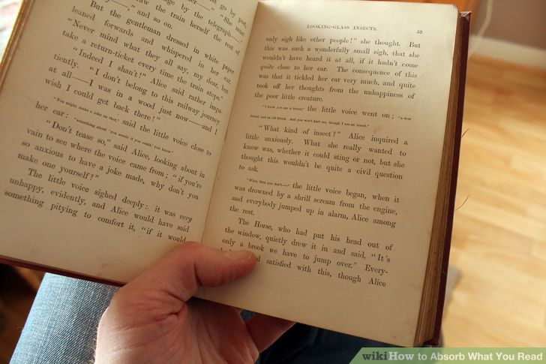
General Sense of the Passage
You can tell by what the passage says what the meaning is.
It is less direct than the others. It is more intuitive.
“Beware the Jabberwock, my son! The jaws that bite, the claws that catch!”
The general sense of the word “beware” above is hinted at by the other words, so it is understood even if you don’t know the word “Beware.”

Slide 8
Remember
There are more context clues, these are just some. There are others that we may look at later.

