Slide 1
The Black Plague
1346-1800s
(The Black Death, The Bubonic Plague)

Slide 2
Pandemic
Bacteria
Viruses
Silk Road
The Black Death
(Yersinia Pestis)

Slide 3
Analysis of the Activity (Empathy)
How would you feel if 60% (⅗) of your classmates and others you knew became ill and eventually died?
What about if it struck your family?
How would you feel if suddenly 20% of the world population fell ill and died?
There are approximately 7 billion people in the world today (350 million in the USA):
20% in modern day terms would be about 1.4 billion
If 60% of America died from a plague, around 210 million would die and 140 million would be left.

Slide 4
Quick History of the Black Plague
Started somewhere in Asia, possibly in the plains.
Travelled west along with travellers and merchant on the silk road.
The silk road was the trade route running from the East (China and India) to the West (Europe, the Middle East, and Africa)
Reached Europe in the 1340s.
The Plague was the first known pandemic of its time, and one of the worst of all time.
A pandemic is comes from “pan” (meaning “all”) and demos (meaning “people”) and means a disease that has spread throughout a large human population.
The following slides will show the spread of the disease throughtout Europe.

Slide 5
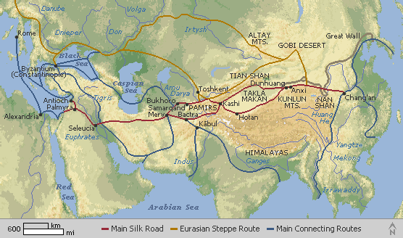

Slide 6
Spread of the Black Plague
The Plague was at its height from 1346-1353 and did the most damage then.

Slide 7
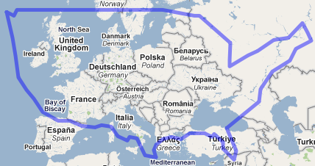
Spread of the Black Plague
The Plague was at its height from 1346-1353 and did the most damage then.

Slide 8
Quick History of the Black Plague
Once the plague arrived in modern-day Crimea (near Ukraine, a peninsula in the Black Sea), it began to be transmitted by...

Slide 9
Quick History of the Black Plague
Once the plague arrived in modern-day Crimea (near Ukraine, a peninsula in the Black Sea), it began to be transmitted by…
Black Rats and the fleas found on them. Often times, the fleas would jump onto a human, biting them, and transmitting the disease.
Rats might also bite humans and transmit the plague that way, as well.
There are two kinds of things that can cause sickness:
Bacteria (considered living organisms)
Viruses (considered not living, but self-replicating)
The Plague was a Bacterium (Yersinia pestis)

Slide 10
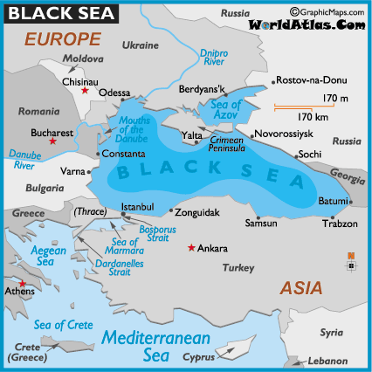

Slide 11
Quick History of the Black Plague
Early forms of treating Plague victims were carried out by the church.
The belief was that if you were struck with such a sickness, then God must be angry with you.
Because of this, their form of treatment was Prayer and Confession.
When that didn’t work and more people started getting sick, the Church changed their methods and started having medical doctors come and treat them.
This finally started to significantly reduce the outbreak. Today, we get our modern day “hospital” from back then.
Quaratine also came into effect at this time, but that is for another time.

Slide 12
Quick History of the Black Plague
The Black Death is estimated to have killed 30–60% of Europe's total population.
In total, the plague reduced the world population from an estimated 450 million down to 350–375 million in the 14th century.
The world population as a whole did not recover to pre-plague levels until the 17th century.
The plague recurred occasionally in Europe until the 19th century.
Plague still exists in various parts of the world.
In 2003, more than 2,100 human cases and 180 deaths were recorded, nearly all of them in Africa.

Slide 13
Quick History of the Black Plague
The last reported serious outbreak was in 2006 in the Democratic Republic of the Congo in Central Africa, when at least 50 people died.
The United States, China, India, Vietnam, and Mongolia are among the other countries that have confirmed human plague cases in recent years.
Wealthier countries have learned how to fight it so it is not as serious as it was.
So… The Question is…
Are Plagues a bad thing?
Is there any good that comes from a Pandemic?

Slide 14
To Be Continued...

